Slide 1



Customer Segmentation
(K-means and RFM Analysis)
BY
ABIAMUWE ESTHER OSARIEMEN

Slide 2


01
Agenda
Problem Statement
Process
Insights
Recommendations

Slide 3

03
Problem Statement
The company is experiencing a significant decline in sales among young professionals .
Lack of personalized customer experiences.
Ineffective customer relationship management.

Slide 4

05
Process
Data Interpretation
Data preprocessing
Data modeling
Customer segmentation
Data Analysis

Slide 5
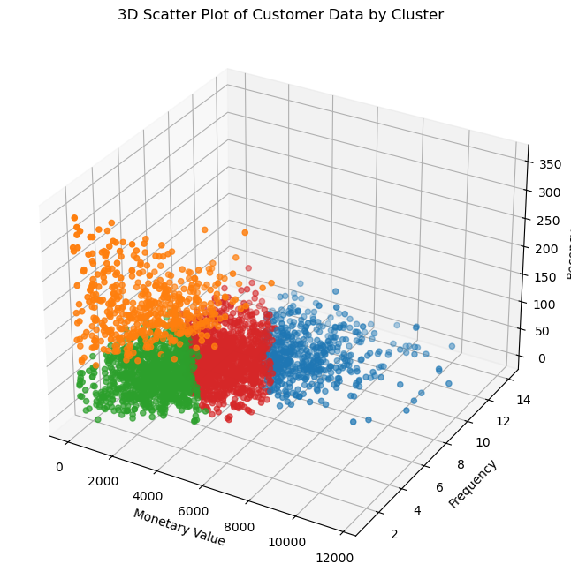
07
Customer Segmentation
K-means model to segment customers based on the RFM analysis
Elbow method and silhouette score

Slide 6

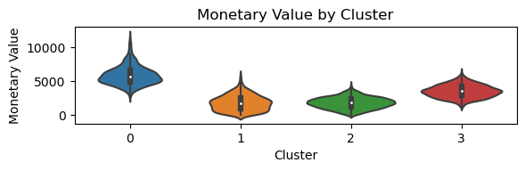
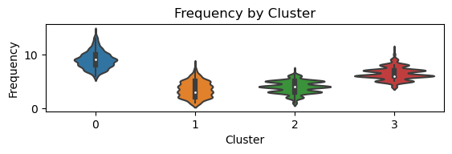
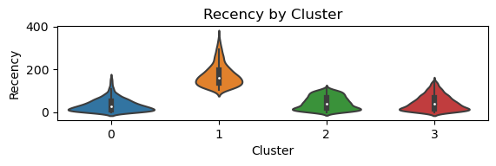

06
Insights
Cluster 0: This cluster represents high-value customers who spend more, purchase more frequently, and make recent purchases. These customers are likely to be loyal to the brand and contribute significantly to revenue.

Slide 7
06
Insights
Cluster 1:This cluster represents customers who spend less, purchase less frequently, and have longer gaps between purchases. They might be less engaged or have lower brand loyalty.

Slide 8
Insights
06
Cluster 2: This cluster represents customers with low spending and frequency, They might be occasional shoppers or those who have recently started engaging with the brand.
Cluster 3: This cluster represents customers with moderate spending and frequency but have high percentage of customers purchasing recently

Slide 9
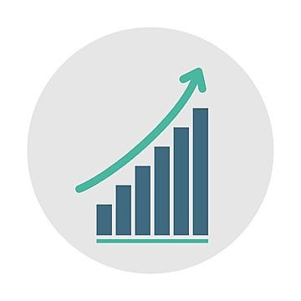
Marketing recommendations
08
Cluster 0 - Premium
Retain
Reward
Cluster 1 - Casual
Re-engage
Encourage
Notes:
Cluster 0:Premium
Cluster 1:Casual
Cluster 2:Dormant
Cluster 3:Active

Slide 10
Marketing recommendations
08
Cluster 2 - Dormant
Re-activate
Educate
Cluster 3 - Active
Retain
Upsell
Notes:
Cluster 0:Premium
Cluster 1:Casual
Cluster 2:Dormant
Cluster 3:Active

Slide 11
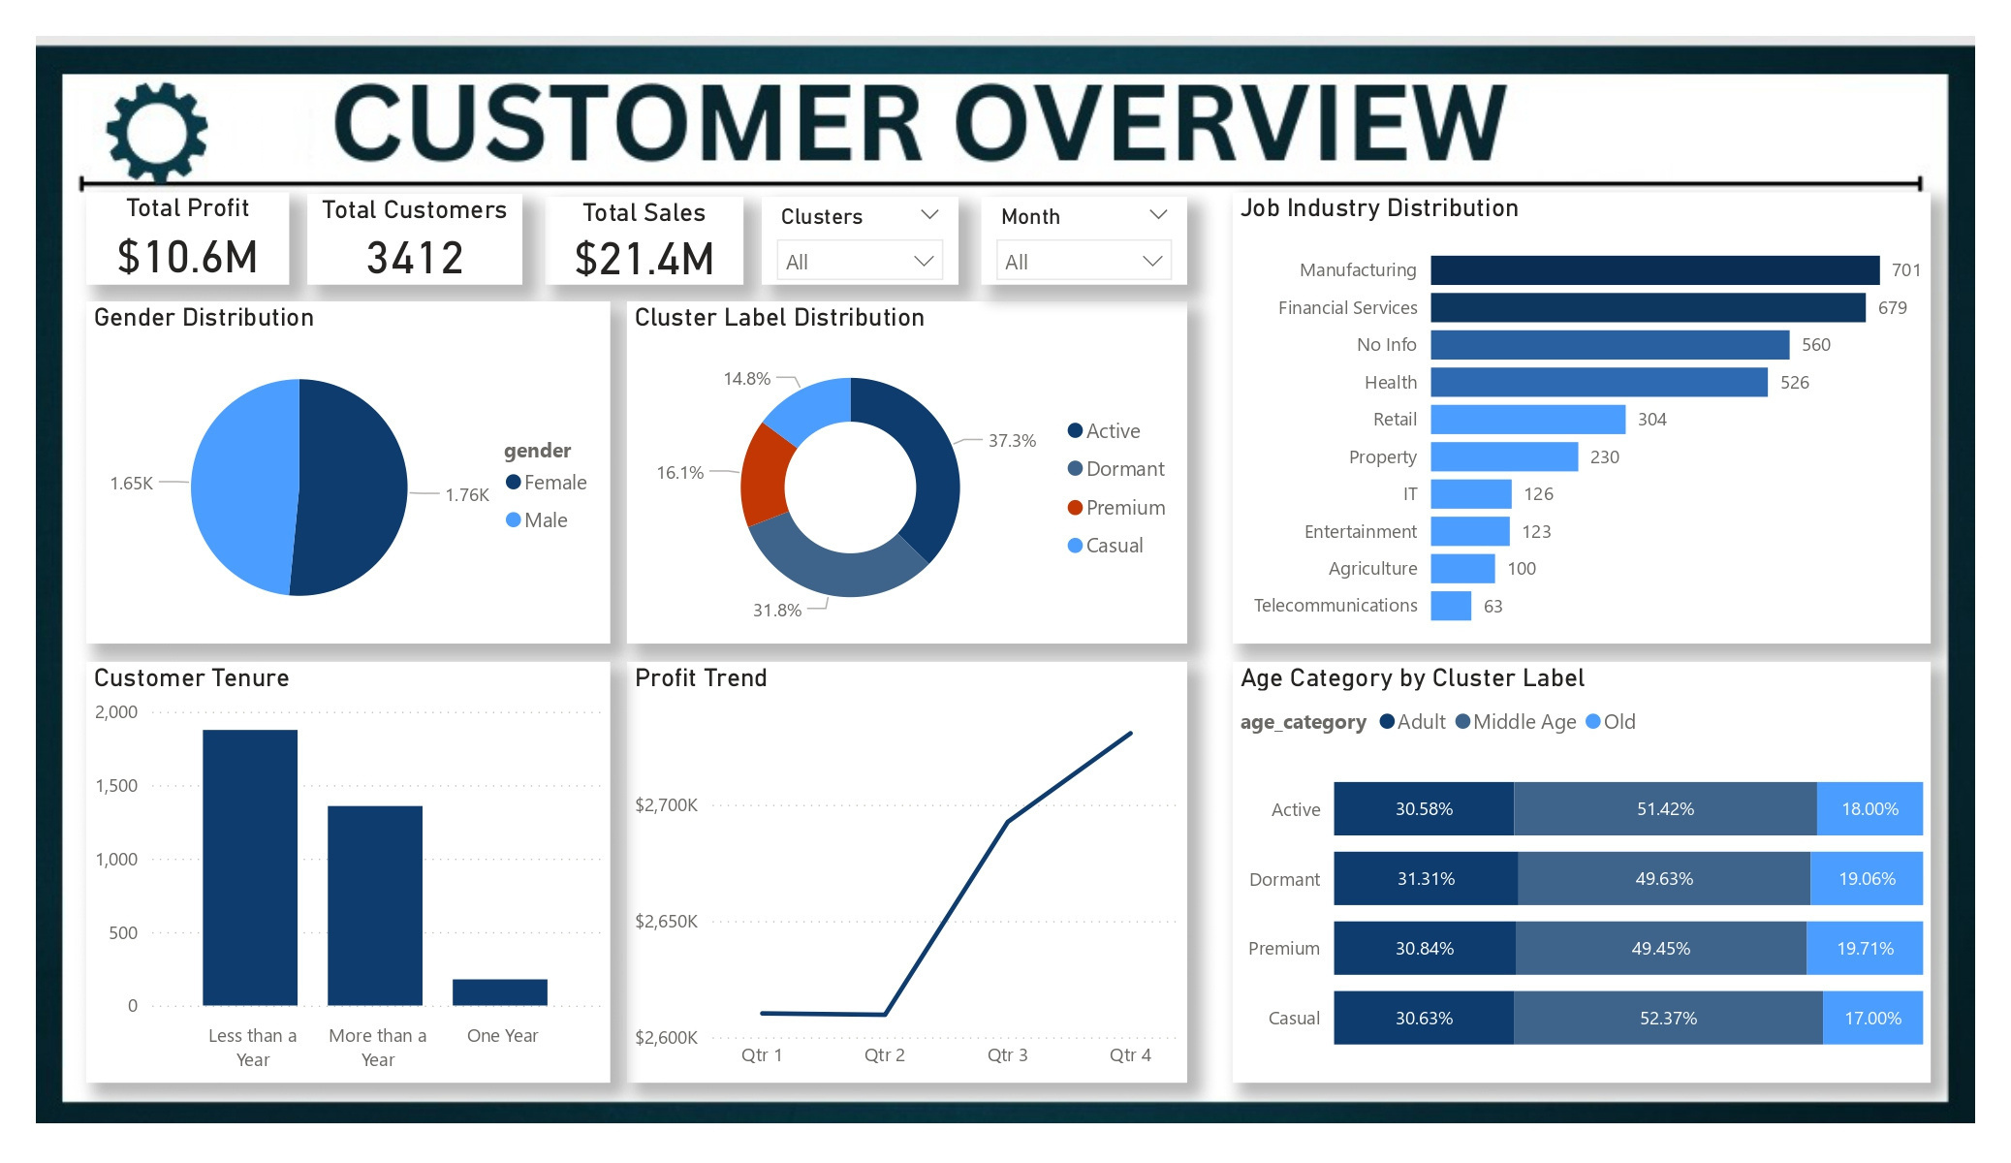
Power BI Dashboard
09

Slide 12
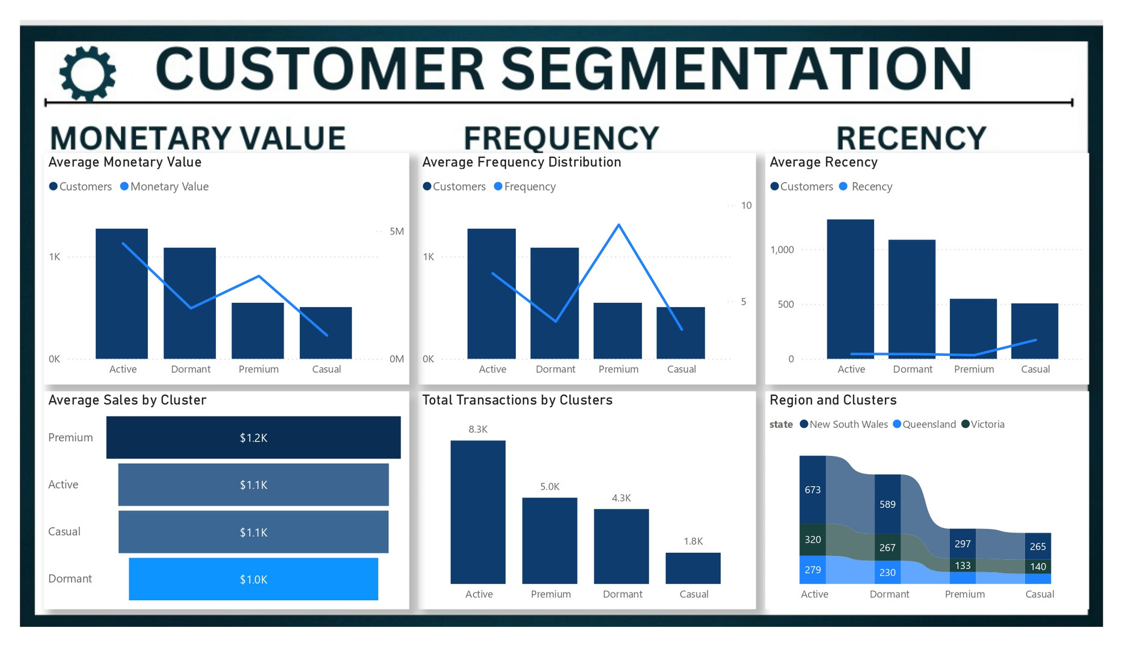
Power BI Dashboard
09

Slide 13
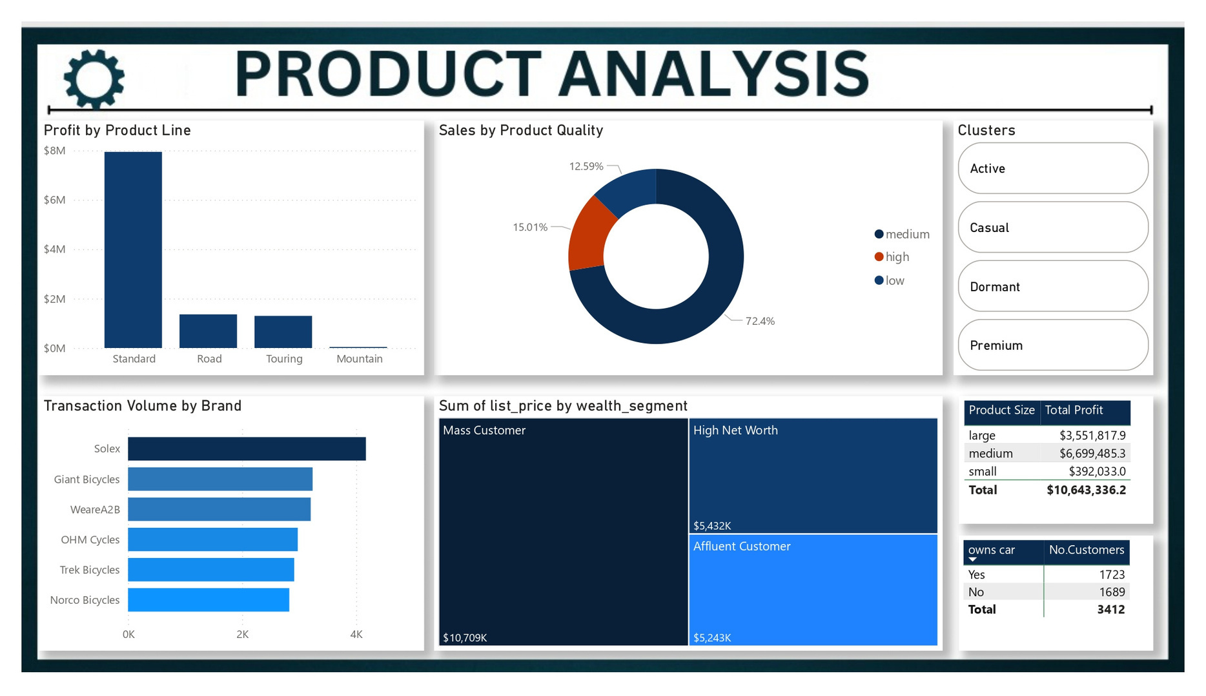
Power BI Dashboard
09

Slide 14




10
Thank you!
Any questions?

